Slide 1
IP Addressing
By Ilian Trifonov

Slide 2
Internet Protocol (IP) address
Numerical label assigned to each device connected to a computer network that uses the Internet Protocol for communication
An IP address serves two principal functions: host or network interface identification and location addressing
IPv4 – 32 bit
IPv6 – 128 bit
Needed to uniquely identify computers on a network and the internet

Slide 3
IP Address
The IP address space is managed globally by the Internet Assigned Numbers Authority (IANA), and by five regional Internet registries (RIR) responsible in their designated territories for assignment to end users and local Internet registries, such as Internet service providers. IPv4 addresses have been distributed by IANA to the RIRs in blocks of approximately 16.8 million addresses each

Slide 4
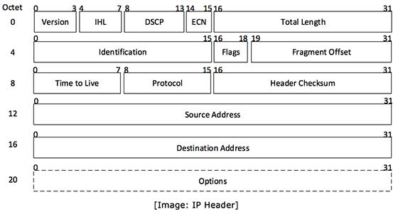
IP Header

Slide 5
IP Header
Version - The first header field in an IP packet is the four-bit version field. For IPv4, this is always equal to 4
Internet Header Length (IHL) - The Internet Header Length (IHL) field has 4 bits, which is the number of 32-bit words. Since an IPv4 header may contain a variable number of options, this field specifies the size of the header (this also coincides with the offset to the data)
Differentiated Services Code Point (DSCP) - Originally defined as the Type of service (ToS) field. New technologies are emerging that require real-time data streaming and therefore make use of the DSCP field. An example is Voice over IP (VoIP), which is used for interactive data voice exchange

Slide 6
IP Header
Explicit Congestion Notification (ECN) - Allows end-to-end notification of network congestion without dropping packets. ECN is an optional feature that is only used when both endpoints support it and are willing to use it
Total Length - This 16-bit field defines the entire packet size in bytes, including header and data
Identification - This field is an identification field and is primarily used for uniquely identifying the group of fragments of a single IP datagram
Flags - A three-bit field follows and is used to control or identify fragments. They are (in order, from most significant to least significant):
bit 0: Reserved; must be zero
bit 1: Don't Fragment (DF)
bit 2: More Fragments (MF)

Slide 7
IP Header
Fragment Offset - The fragment offset field is measured in units of eight-byte blocks. It is 13 bits long and specifies the offset of a particular fragment relative to the beginning of the original unfragmented IP datagram. The first fragment has an offset of zero
Time To Live (TTL) - An eight-bit time to live field helps prevent datagrams from persisting (e.g. going in circles) on an internet. This field limits a datagram's lifetime. It is specified in seconds, but time intervals less than 1 second are rounded up to 1. In practice, the field has become a hop count—when the datagram arrives at a router, the router decrements the TTL field by one. When the TTL field hits zero, the router discards the packet and typically sends an ICMP Time Exceeded message to the sender

Slide 8
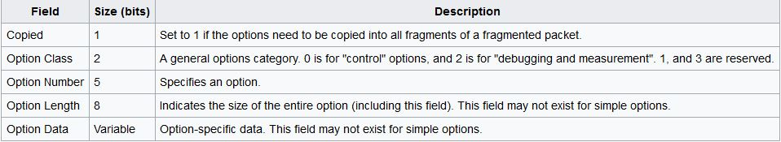
IP Header
Protocol - This field defines the protocol used in the data portion of the IP datagram
Header Checksum - The 16-bit checksum field is used for error-checking of the header
Source address - This field is the IPv4 address of the sender of the packet.
Destination address - This field is the IPv4 address of the receiver of the packet.
Options - The options field is not often used.

Slide 9
IP Address
It is used to uniquely identify each host on a network
The header of each IP packet contains the IP address of the sending host, and that of the destination host

Slide 10
IP Addresses
213.130.72.18 – dotted quad notation
Each number between the dots is between 0 and 255
Each number is an octet
Octet is a unit of digital information in computing and telecommunications that consists of eight bits

Slide 11
How do we convert binary to decimal?
128(2^7) | 64(2^6) | 32(2^5) | 16(2^4) | 8(2^3) | 4(2^2) | 2(2^1) | 1 (2^0)
1 | 0 | 1 | 0 | 0 | 1 | 0 | 0
128 +0 +32 +0 +0 +4 +0 +0
= 164

Slide 12
IP Address
IP is actually in the format xxxxxxxx.xxxxxxxx.xxxxxxxx.xxxxxxxx
The IP 213.130.72.18 is ‭11010101‬.10000010‬.‭01001000‬.‭00010010‬

Slide 13
IP address classes
A, B, C – For allocating IP addresses
D – For multicasting
E – Reserved for experimental use
The leading bits identify the class

Slide 14
Class A
Network = N Host=H
0NNNNNNN.HHHHHHHH.HHHHHHHH.HHHHHHHH
Leading bit
24 bits
2^24 Hosts (16 777 216 – 2)
The first and last address are reserved for network and broadcast
7 bits
2^7 networks (128)

Slide 15
Class B
Network = N Host=H
10NNNNNN.NNNNNNNN.HHHHHHHH.HHHHHHHH
Leading bits
16 bits
2^16 Hosts (65 536 – 2)
The first and last address are reserved for network and broadcast
14 bits
2^14 networks (16 384)

Slide 16
Class C
Network = N Host=H
110NNNNN.NNNNNNNN.NNNNNNNN.HHHHHHHH
Leading bits
8 bits
2^8 Hosts (256 – 2)
The first and last address are reserved for network and broadcast
21 bits
2^21 networks (2 097 152)

Slide 17
IP Address Class ranges
Class | 1st Octet Decimal Range | 1st Octet High Order Bits
A | 1-126 | 0
B | 128-191 | 10
C | 192-223 | 110
D | 224-239 | 1110
E | 240-254 | 1111

Slide 18
Subnet Mask
The subnet mask is used by the TCP/IP protocol to determine whether a host is on the local subnet or on a remote network.
For example using a 255.255.255.0 subnet mask, and an IP 192.168.1.32:
192.168.1.X – On the local subnet
111.15.5.14 – On a remote network

Slide 19
Subnet Mask
Class A – 255.0.0.0 – 11111111.00000000.00000000.00000000
Class B – 255.255.0.0 – 11111111. 11111111.00000000.00000000
Class C – 255.255.255.0 – 11111111. 11111111. 11111111.00000000

Slide 20
Special IP Addresses
Loopback address – 127.0.0.0
Broadcast address – All host bits are set to 1, and any data sent to this address will be sent to all addresses connected to the network
Class A – X.255.255.255
Class B – X.X.255.255
Class C – X.X.X.255
Network address - All host bits are set to 0. Examples:
Class A – X.0.0.0
Class B – X.X.0.0
Class C – X.X.X.0

Slide 21
IPv4 Address count
4,294,967,296 possible IPv4 addresses
This is less than the population of the earth, not to mention that each person can have multiple devices
This is the reason for Network Address Translation and Private IP address spaces (Private Network)

Slide 22
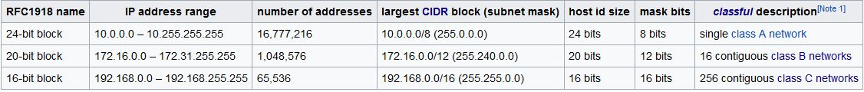

Private network reserved address spaces
IPv4
IPv6

Slide 23
Classless Inter-Domain Routing (CIRD)
Currently used instead of the classful network design
Its goal was to slow the growth of routing tables on routers across the Internet, and to help slow the rapid exhaustion of IPv4 addresses
Classless Inter-Domain Routing allocates address space to Internet service providers and end users on any address bit boundary, instead of on 8-bit segments
It is based on the variable-length subnet masking (VLSM) technique with effective qualities of specifying arbitrary-length prefixes. CIDR introduced a new method of representation for IP addresses, now commonly known as CIDR notation

Slide 24
CIDR notation
It is a compact representation of an IP address and its associated routing prefix. The notation is constructed from an IP address, a slash ('/') character, and a decimal number. The number is the count of leading 1 bits in the routing mask, traditionally called the network mask
The address may denote a single, distinct interface address or the beginning address of an entire network. The maximum size of the network is given by the number of addresses that are possible with the remaining, least-significant bits below the prefix

Slide 25
CIDR notation example
192.168.100.14/24 represents the IPv4 address 192.168.100.14 and its associated routing prefix 192.168.100.0, or equivalently, its subnet mask 255.255.255.0, which has 24 leading 1-bits.
the IPv4 block 192.168.100.0/22 represents the 1024 IPv4 addresses from 192.168.100.0 to 192.168.103.255.
the IPv6 block 2001:db8::/48 represents the block of IPv6 addresses from 2001:db8:0:0:0:0:0:0 to 2001:db8:0:ffff:ffff:ffff:ffff:ffff.
::1/128 represents the IPv6 loopback address. Its prefix size is 128, the size of the address itself.

Slide 26
Routing tables
Each router has a routing table
It contains records for where to route packets to
Each record is binary, and packets are routed by matching the bits left to right
The longest match wins
CIDR notation is used, and the longest match is denoted with the highest number behind the “/”

Slide 27
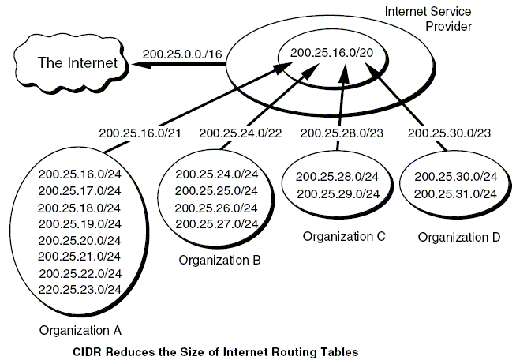
Routing table example

Slide 28
Routing
We have to get to IP address 89.2.33.12
The routing table has entries for:
89.2/16
145.23.1/24
86/8
89.2.33/24
It picks “89.2.33/24” because it is the longest, and routes to the next hop

Slide 29
Questions?

